Slide 1
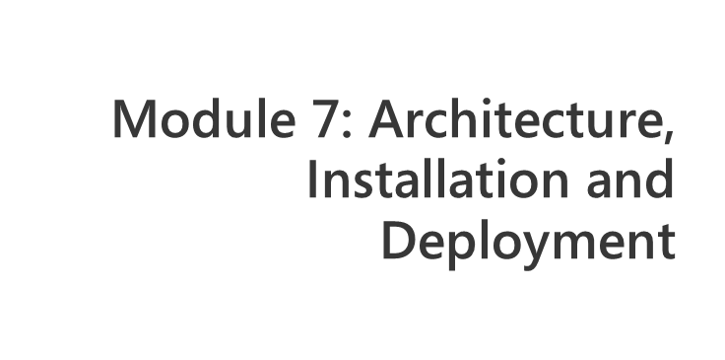
Notes:
Module x: Title
Course xxxxy
Presentation: xx minutes
Lab: xx minutes
This module helps students to ….
After completing this module, students will be able to:
Objective #1.
Objective #2.
Objective #3.
Required materials
To teach this module, you need the Microsoft Office PowerPoint® file xxxxy_xx.ppt.
Important It is recommended that you use PowerPoint 2002 or a later version to display the slides for this course. If you use PowerPoint Viewer or an earlier version of PowerPoint, all the features of the slides might not be displayed correctly.
Preparation tasks
To prepare for this module:
Read all of the materials for this module.
Practice performing the demonstrations and the lab exercises.
Work through the Module Review and Takeaways section and determine how you will use this
section to reinforce student learning and promote knowledge transfer to on-the-job performance.
If this is a KonaH product, use this section:
Make sure that students are aware that there are additional information and resources for the module on the Course Companion CD.
If this is a Forte product, use this section:
Make sure that students are aware that there are additional online resources for the module on the Course CD.

Slide 2
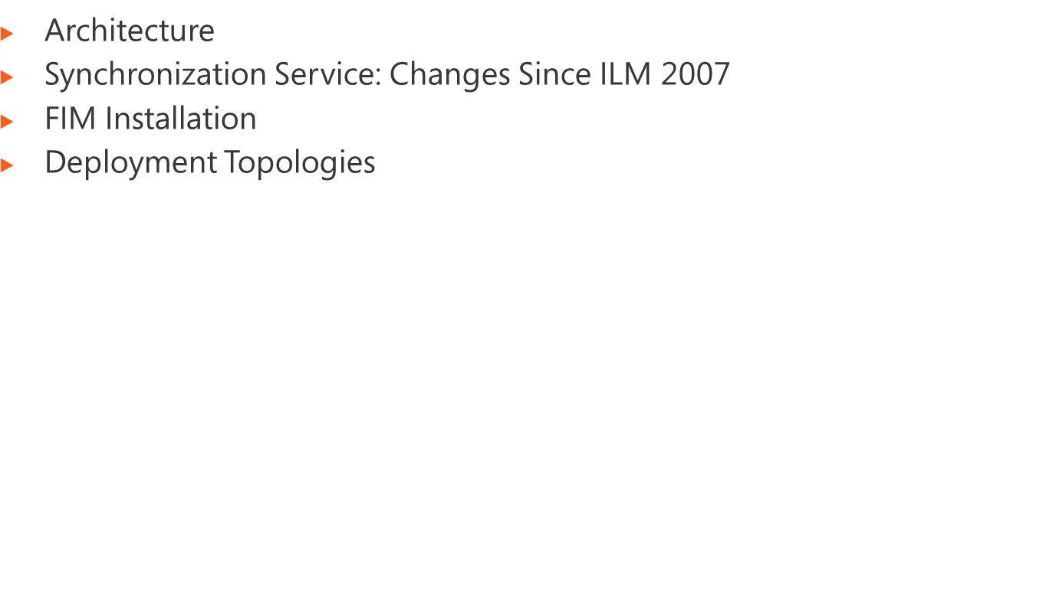
Notes:
Module x: Title
Course xxxxy

Slide 3
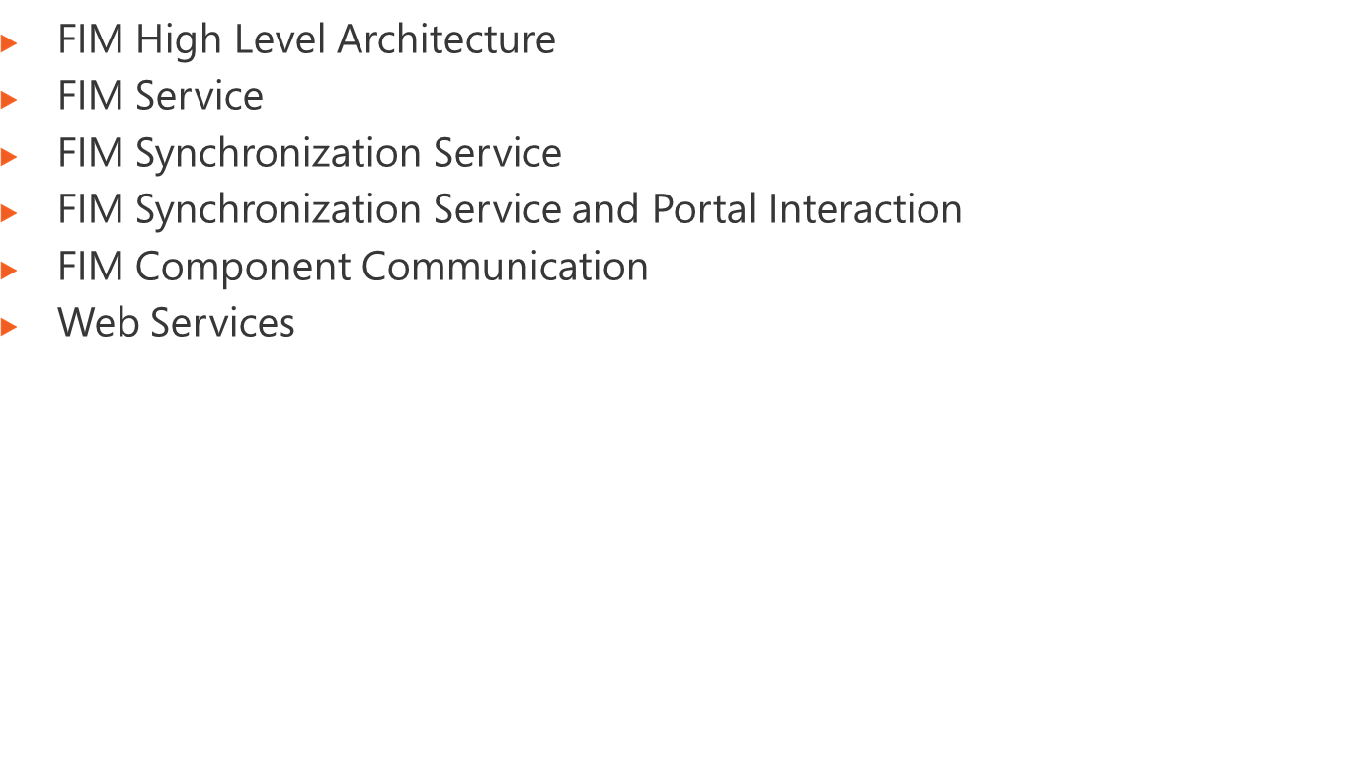
Notes:
Module x: Title
Course xxxxy

Slide 4




















Solutions
Group
Mgmt
User
Mgmt
Credential
Mgmt
Policy
Mgmt
Custom
FIM Clients
Outlook
Portal
Windows
Custom
Portal
FIM Platform
FIM Service
FIM Sync
FIM CS
App
DB
Sync
DB
CS
DB
Request
Processor
Delegation
& Permissions
AuthN
Workflow
AuthZ
Workflow
Action
Workflow
MAs
Cert Mgmt
Identity Stores
Directories
Applications
Databases
E-Mail Systems
Notes:
Module x: Title
Course xxxxy

Slide 5
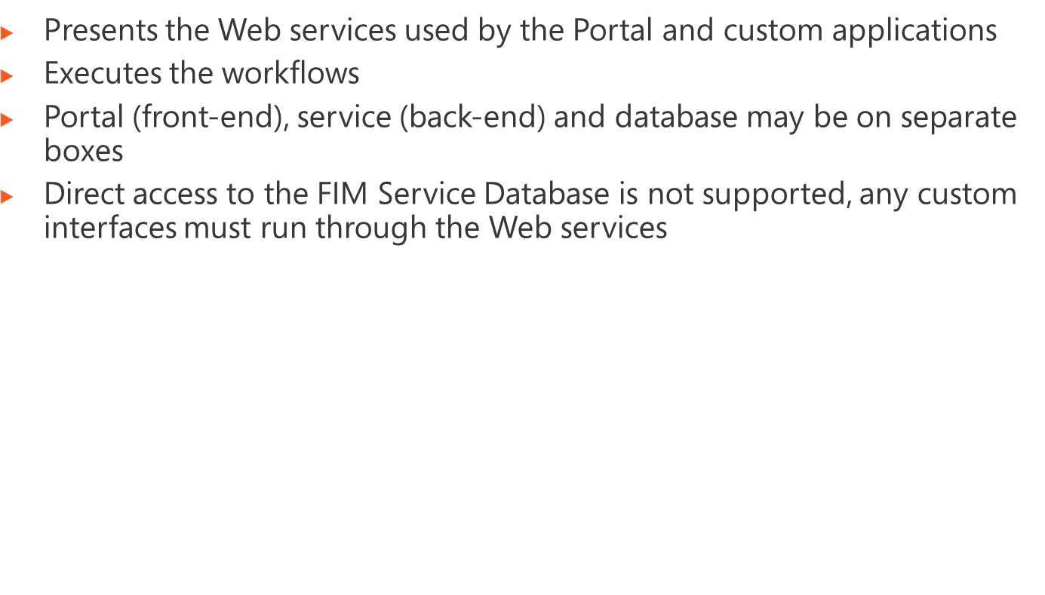
FIM Service
App
DB
Request
Processor
Delegation
& Permissions
AuthN
Workflow
AuthZ
Workflow
Action
Workflow
Notes:
Module x: Title
Course xxxxy

Slide 6
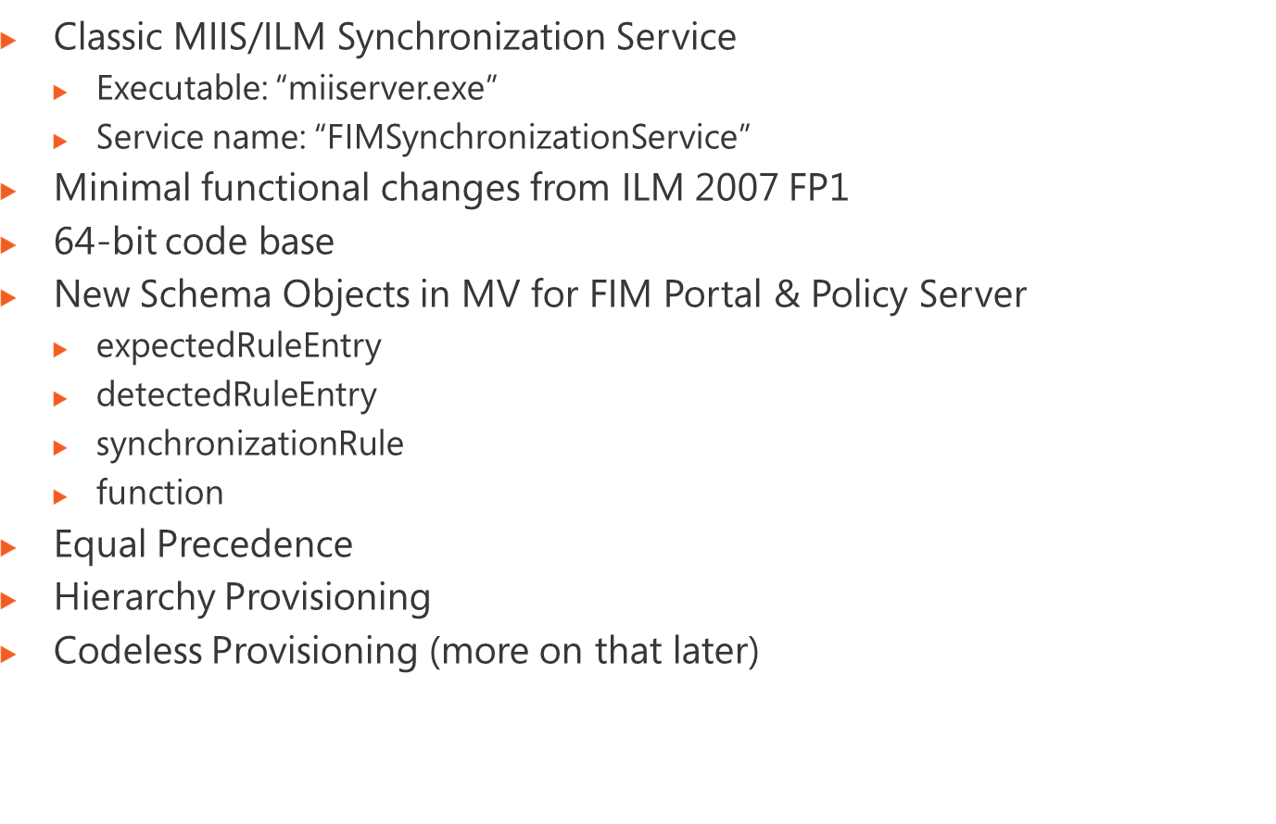
FIM Sync
Sync
DB
MAs
Identity Stores
Directories
Applications
Databases
E-Mail Systems
Notes:
Module x: Title
Course xxxxy

Slide 7
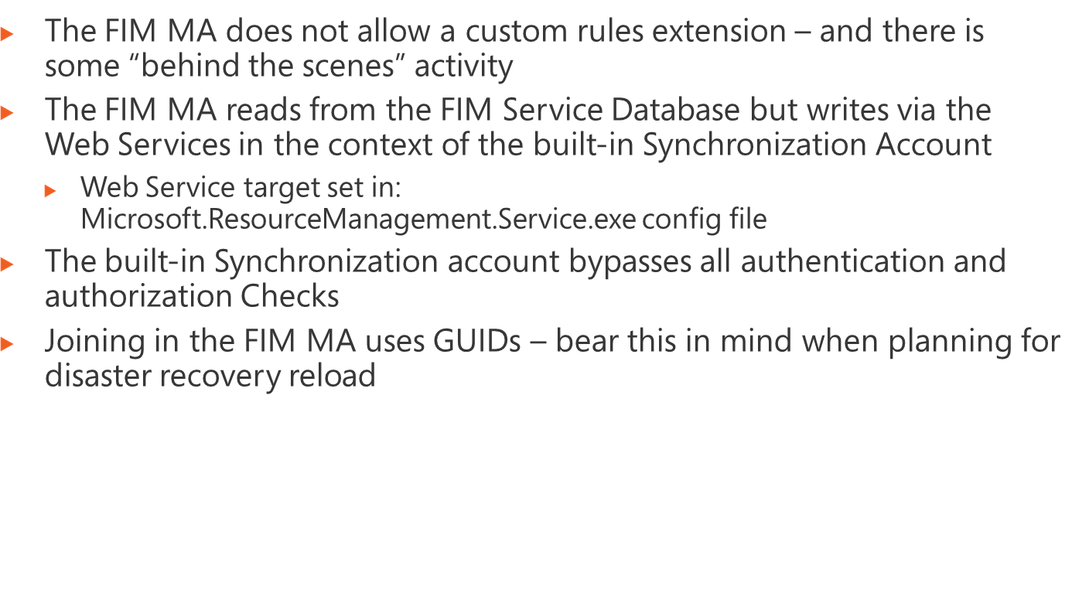
Notes:
Module x: Title
Course xxxxy

Slide 8
FIM
Portal
FIM Add-in for Outlook 2007 (XP or Vista)
FIM Password Reset Extensions (XP or Vista)
Custom Apps
Active Directory
Other
Data
Sources
PCNS
WSS 3.0
MAPI
IIS 7.0
Exchange
2007
SOAP
LDAP
RPC (WMI)
SOAP
Protocol X
SOAP
SOAP
FIM Service
(Windows Communication Foundation
and Windows Workflow Foundation)
FIM
Synchronization
Service
FIM
Certificate
Management
Service
SOAP
.NET
CLM API
SQL
SQL
SQL
SQL
SQL Server 2008
(FIM Service Database)
SQL Server 2008
(FIM Synchronization Service Database)
SQL Server 2008
(FIM Certificate Management Database)
Notes:
Module x: Title
Course xxxxy

Slide 9
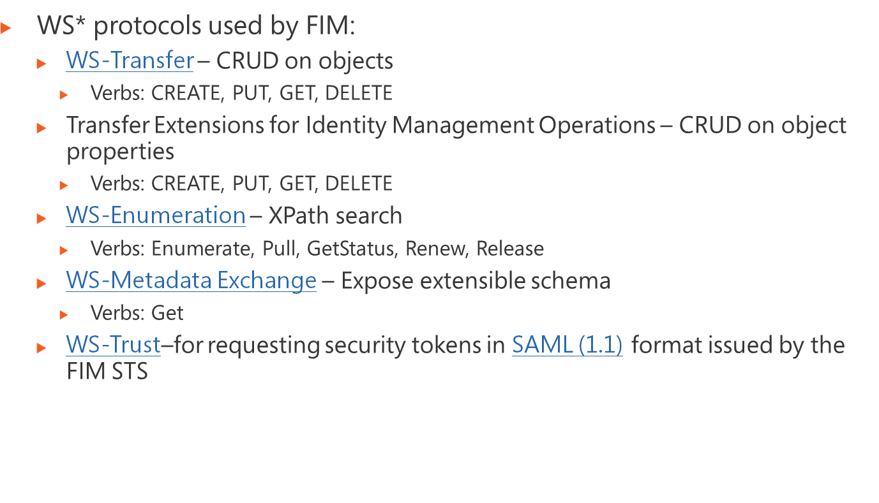
Notes:
Module x: Title
Course xxxxy

Slide 10
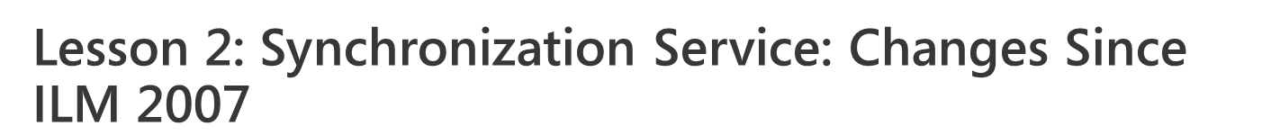
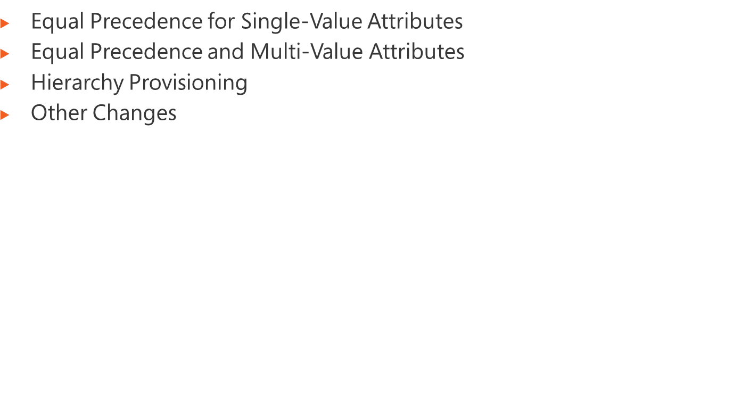
Notes:
Module x: Title
Course xxxxy

Slide 11
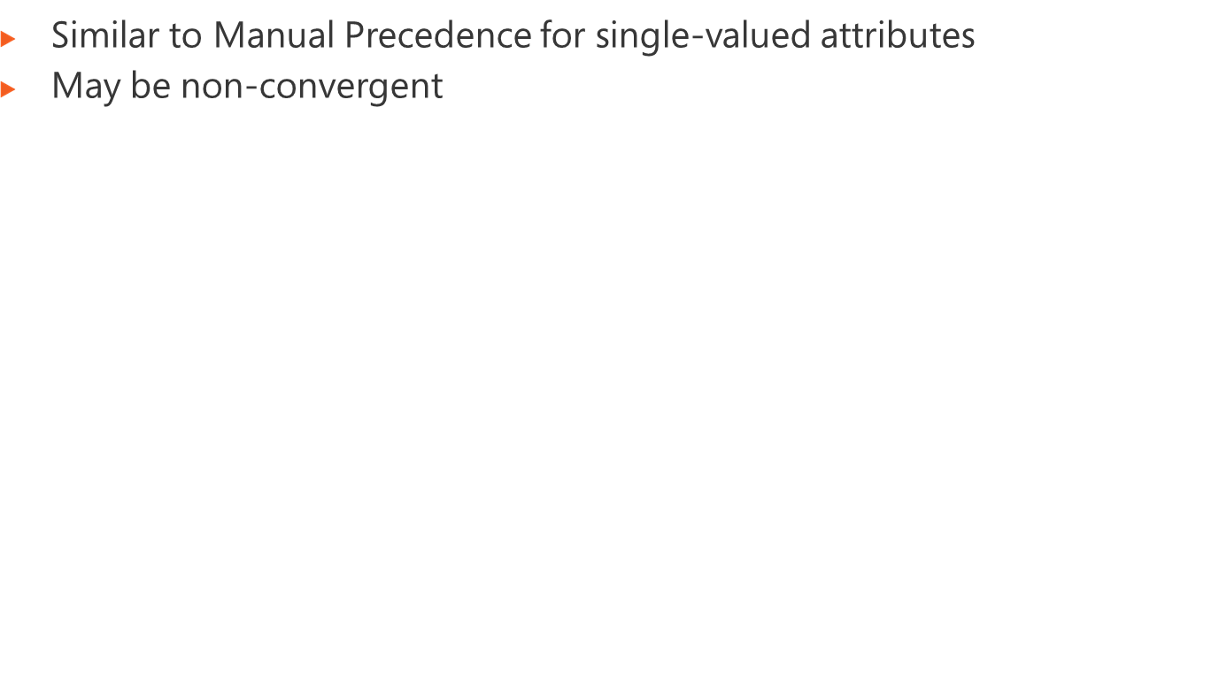

Metaverse
Human Resources
1
CIO
Active Directory
CEO
2
CIO
CEO
3
CIO
Notes:
Module x: Title
Course xxxxy

Slide 12
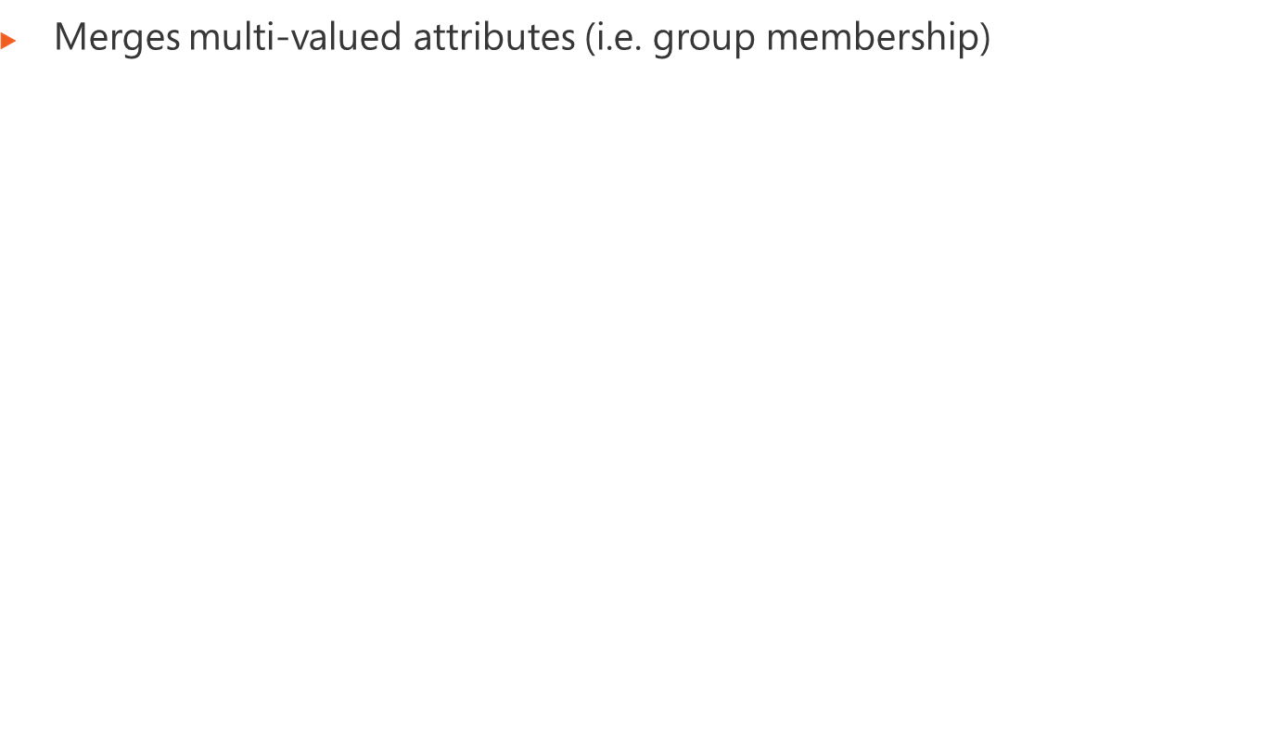

Metaverse
ADAM/AD LDS
Active Directory
Samantha Smith
1
Brian Perry
2
Eric Swift
Samantha Smith
Samantha Smith
Brian Perry
Eric Swift
Notes:
Module x: Title
Course xxxxy

Slide 13
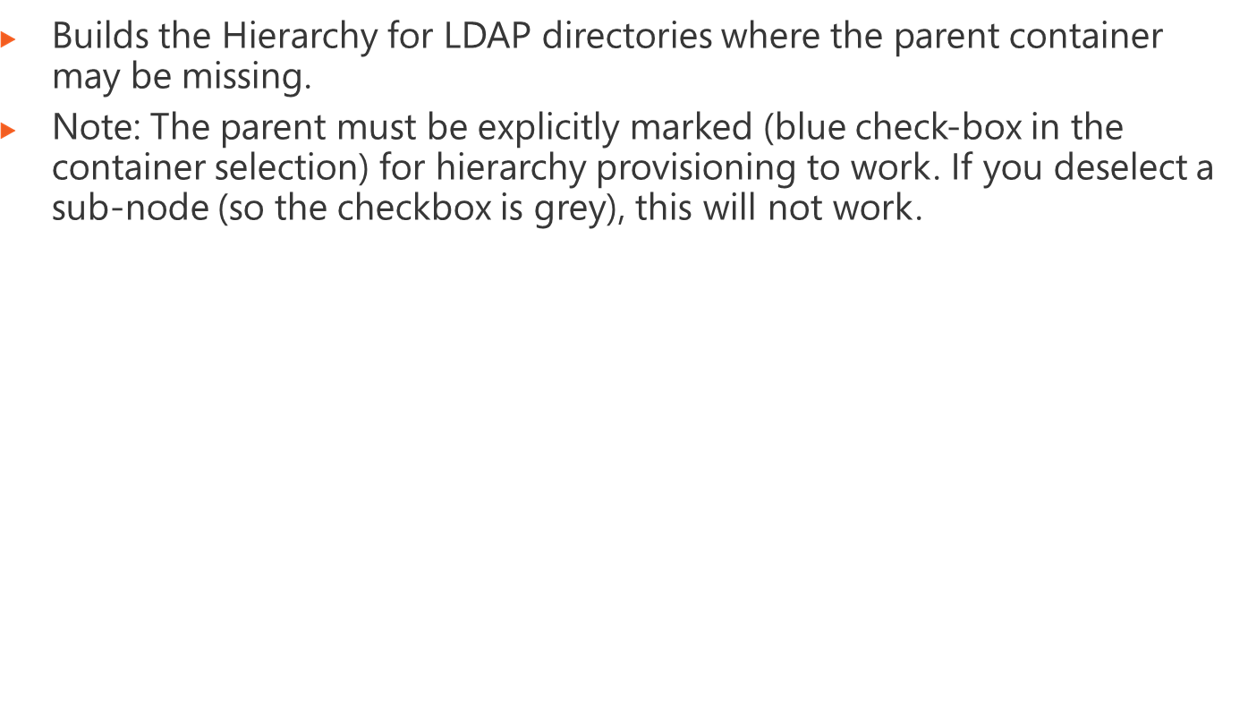
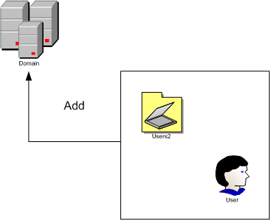
Notes:
Module x: Title
Course xxxxy

Slide 14
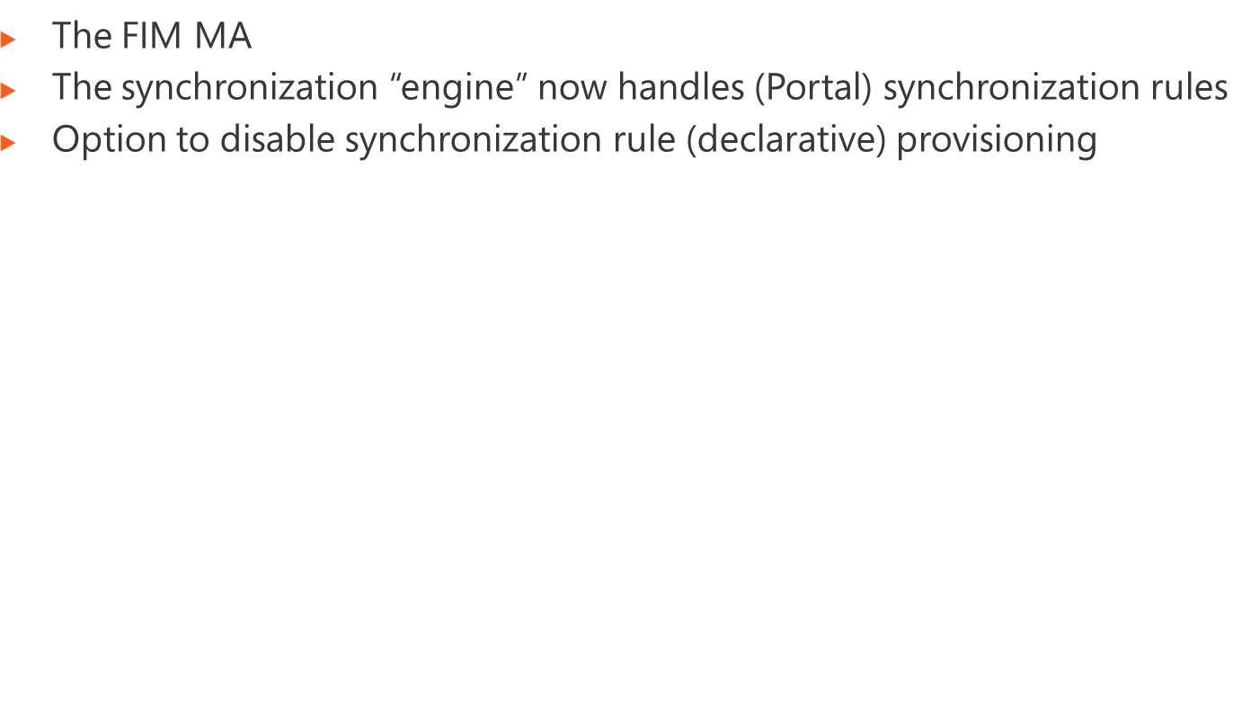
Notes:
Module x: Title
Course xxxxy

Slide 15
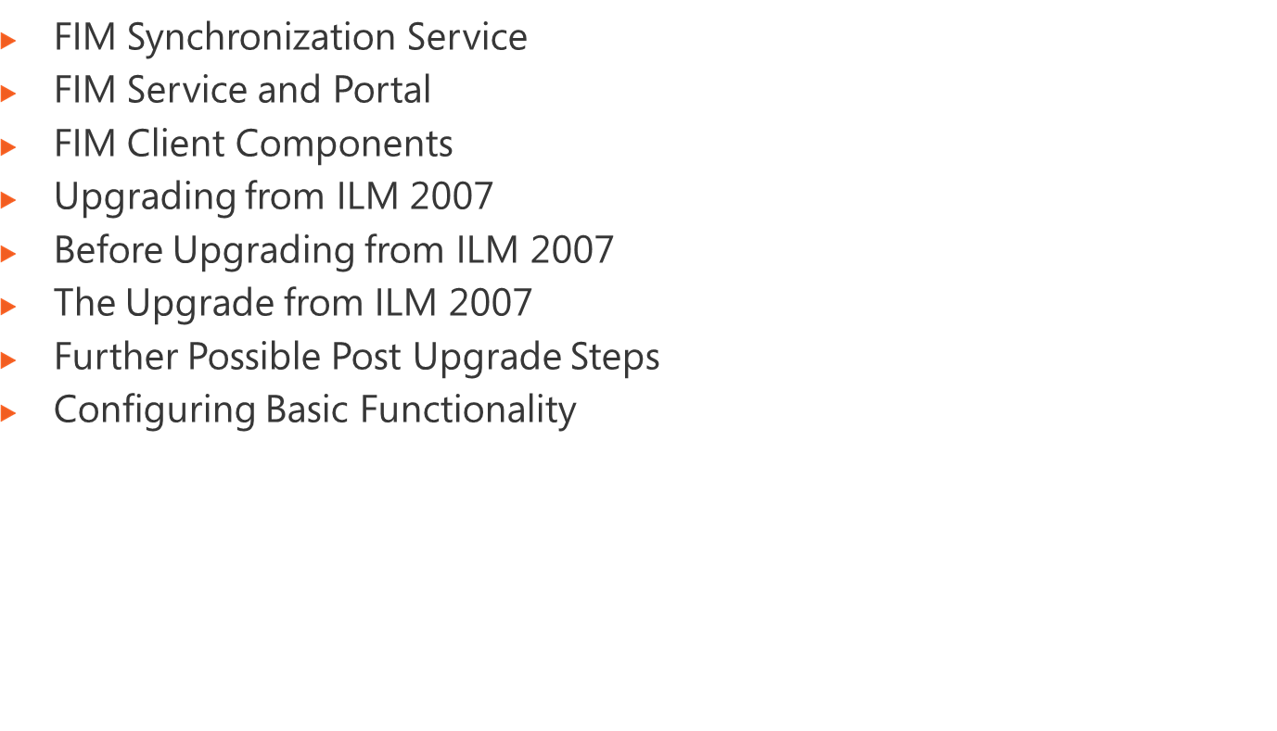
Notes:
Module x: Title
Course xxxxy

Slide 16
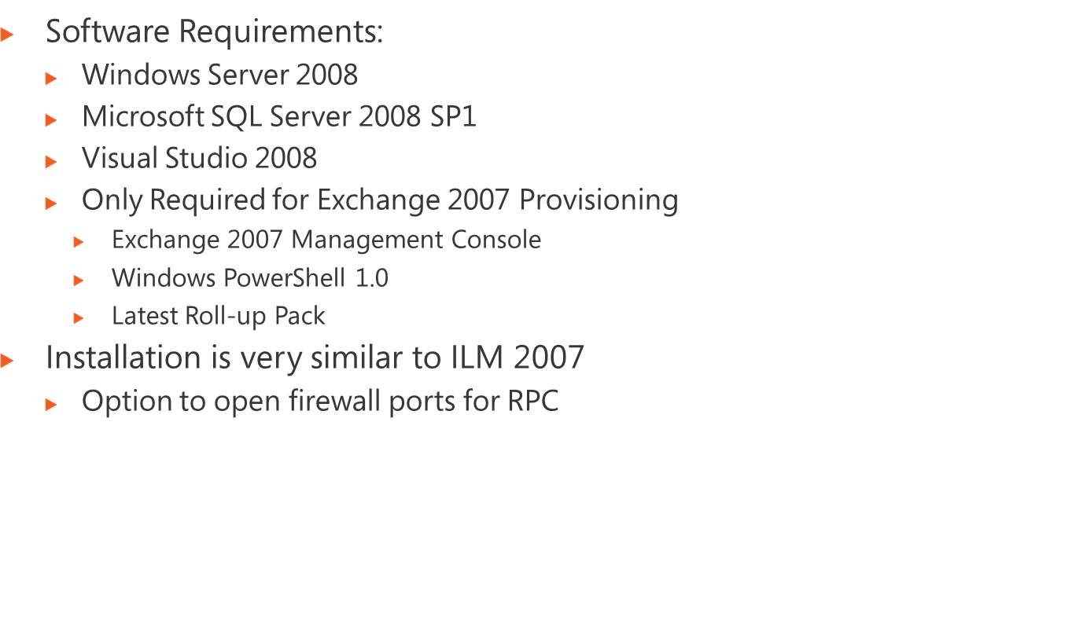
Notes:
Module x: Title
Course xxxxy

Slide 17
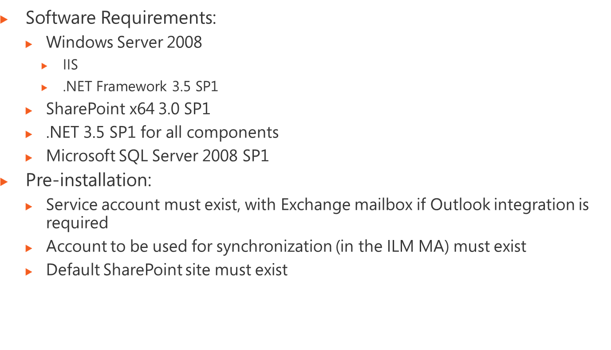
Notes:
Module x: Title
Course xxxxy

Slide 18
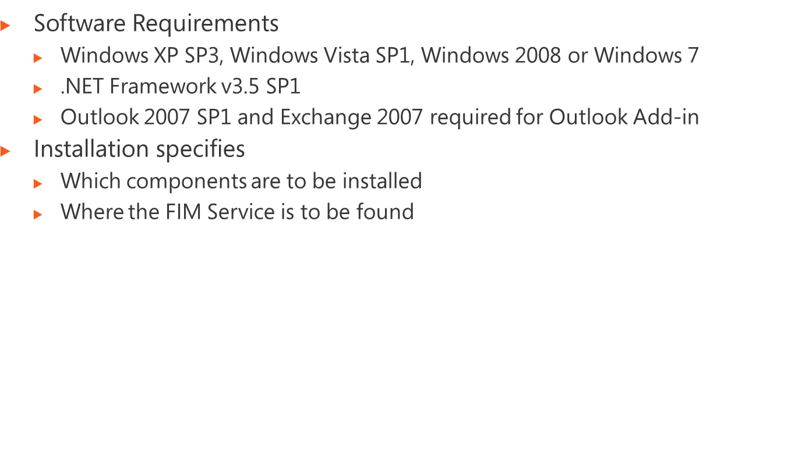
Notes:
Module x: Title
Course xxxxy

Slide 19
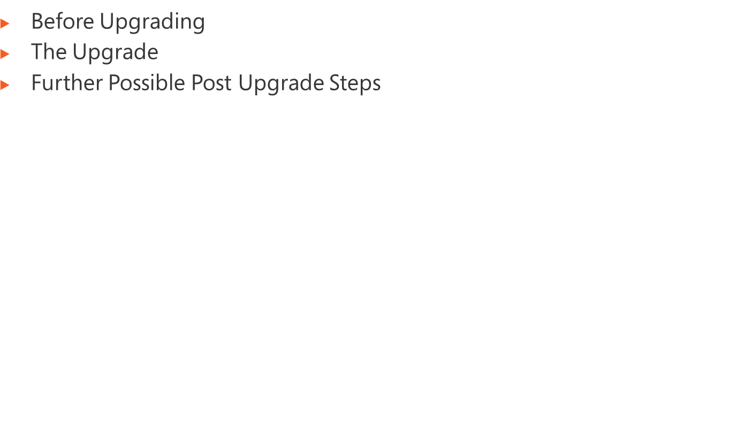
Notes:
Module x: Title
Course xxxxy

Slide 20
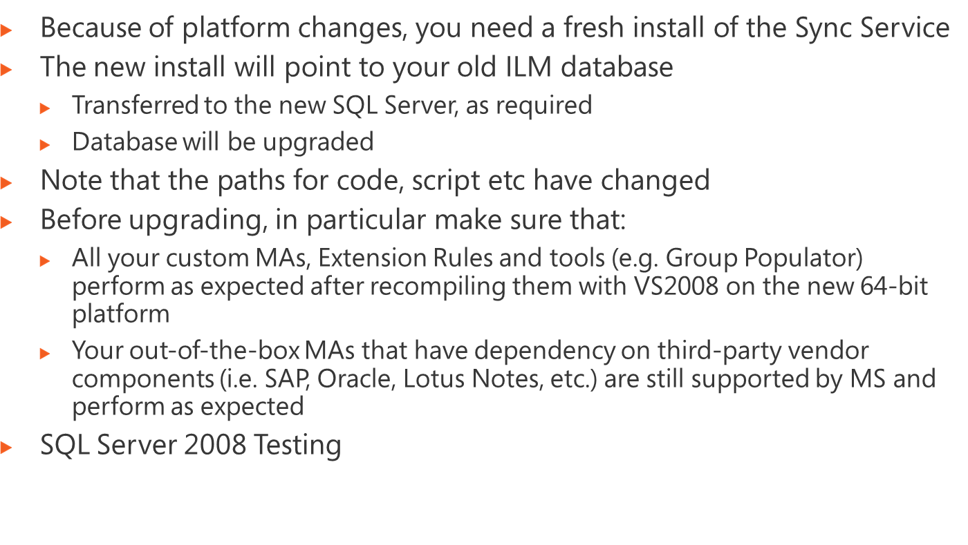
Notes:
Module x: Title
Course xxxxy

Slide 21
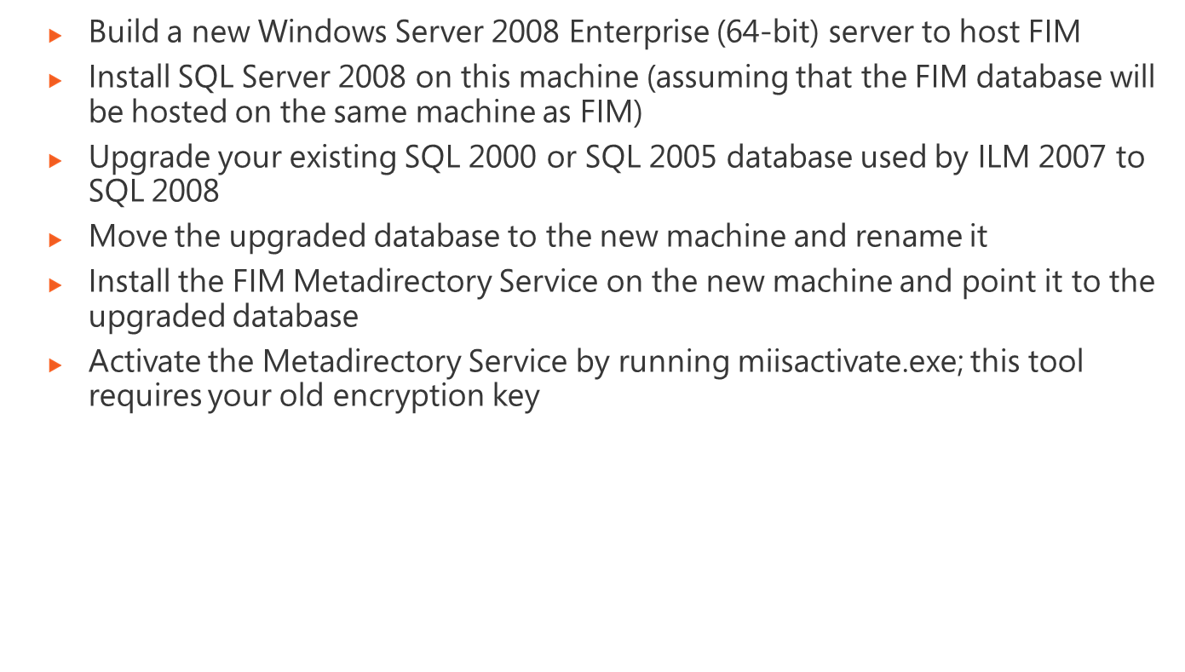
Notes:
Module x: Title
Course xxxxy

Slide 22
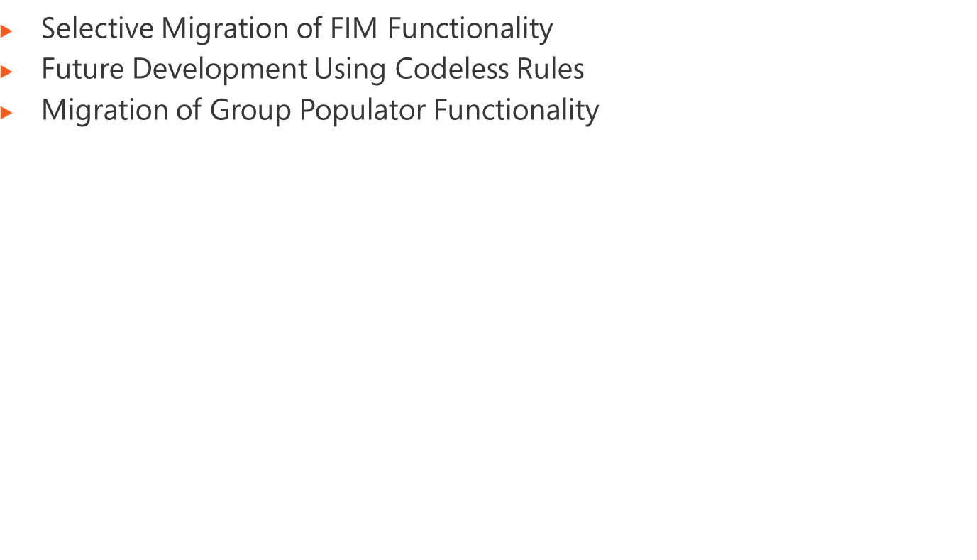
Notes:
Module x: Title
Course xxxxy

Slide 23
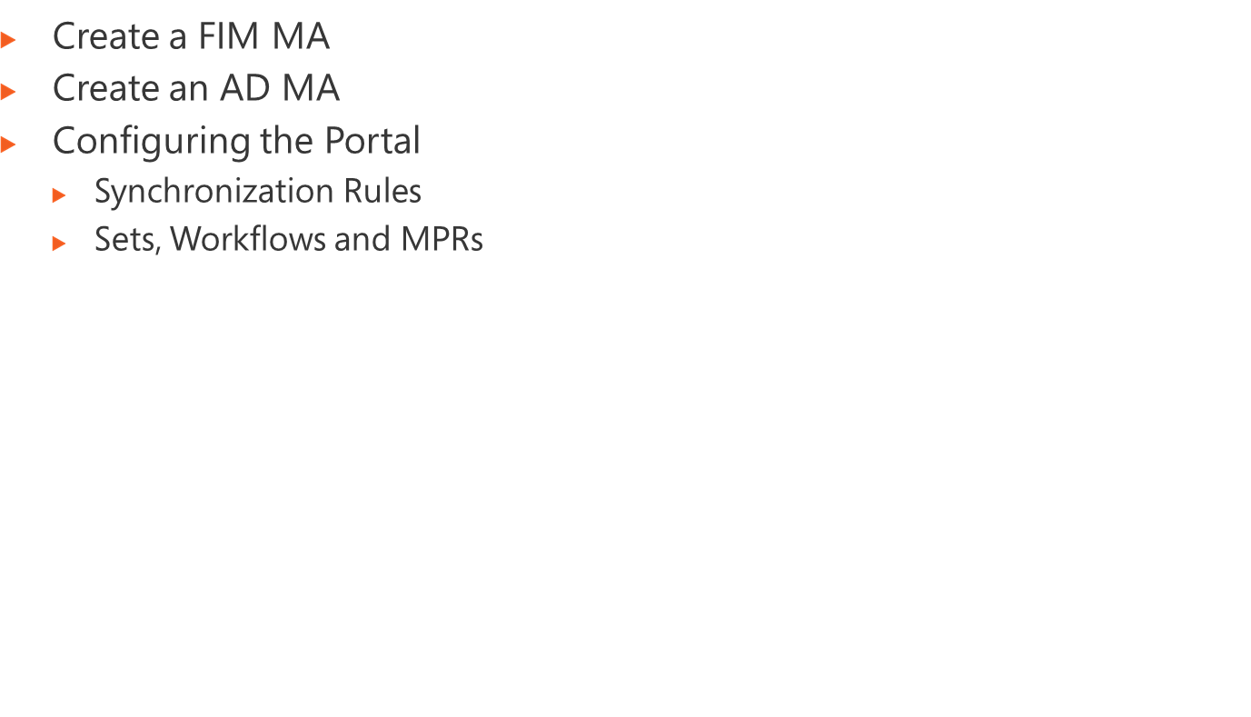
Notes:
Module x: Title
Course xxxxy

Slide 24
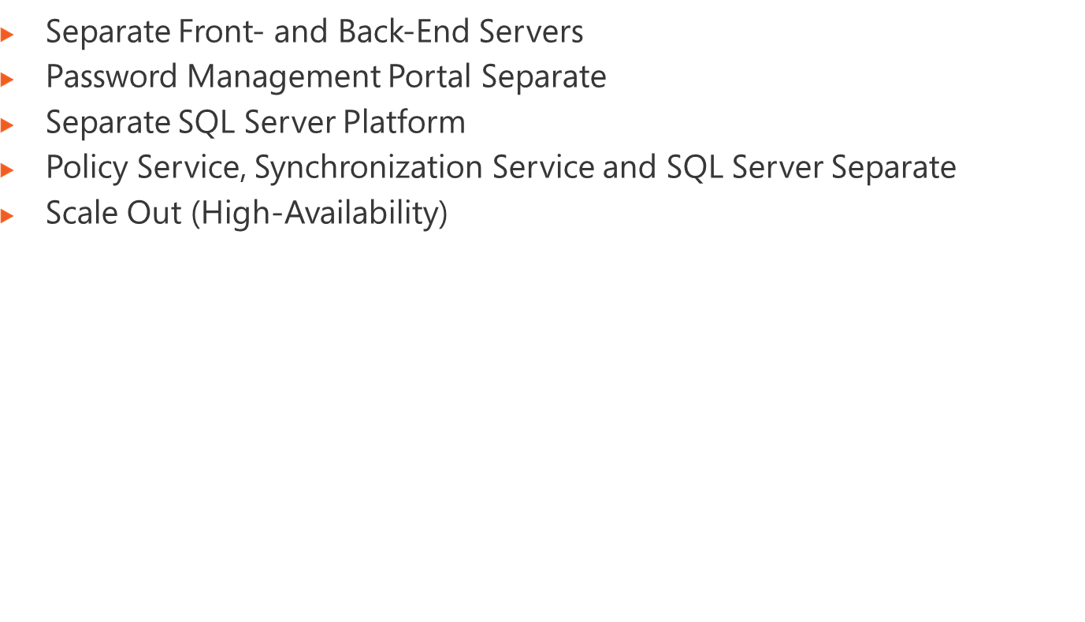
Notes:
Module x: Title
Course xxxxy

Slide 25
Single Active Directory Domain
Server 1
Server 2
FIM
Portal
FIM
Service
FIM
Synchronization
Service
WSS 3.0
IIS 7.0
SQL Server 2008
Notes:
Module x: Title
Course xxxxy

Slide 26
Single Active Directory Domain
Server 1
Server 2
Server 3
FIM Portal (Password Management)
FIM Portal
FIM
Service
FIM
Synchronization
Service
WSS 3.0
WSS 3.0
IIS 7.0
IIS 7.0
SQL Server 2008
Notes:
Module x: Title
Course xxxxy

Slide 27
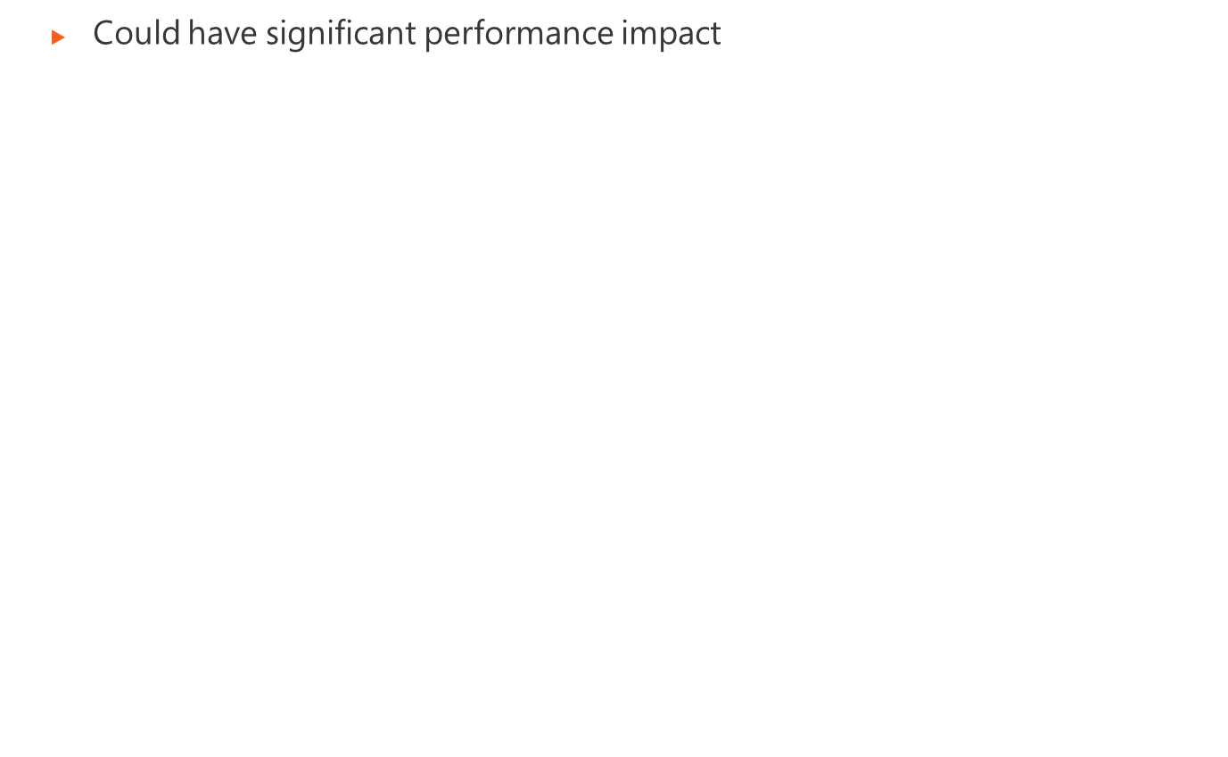
Single Active Directory Domain
Server 1
Server 2
Server 3
FIM Portal (Password Management)
FIM Portal
FIM
Service
FIM
Synchronization
Service
WSS 3.0
WSS 3.0
IIS 7.0
IIS 7.0
Server 4 or SQL Server Cluster
SQL Server 2008
Notes:
Module x: Title
Course xxxxy

Slide 28

Single Active Directory Domain
Server 1
Server 2
Server 3
Server 4
FIM Portal (Password Management)
FIM Portal
FIM
Service
FIM
Synchronization
Service
WSS 3.0
WSS 3.0
IIS 7.0
IIS 7.0
Server 5 or SQL Server Cluster
SQL Server 2008
Notes:
Module x: Title
Course xxxxy

Slide 29
SharePoint Farm
SharePoint Farm
Multiple Servers
FIM Portal (Password Management)
FIM Portal
FIM Service
FIM Portal (Password Management)
FIM Portal (Password Management)
FIM Portal (Password Management)
FIM Portal (Password Management)
FIM Portal (Password Management)
FIM Portal (Password Management)
WSS 3.0
WSS 3.0
IIS 7.0
IIS 7.0
Load
Balancer
SQL Server Cluster
Primary Server
Standby Server
FIM
Synchronization
Service
FIM
Synchronization
Service
SQL Server 2008
SQL Server 2008
Notes:
Note that in Beta3 SharePoint uses the Windows Internal Database
Plan to support SQL Server in RC
Module 4: Managing Security
Course 2786B

